Slide 1

Numpy, Pandas, Matplotlib 基礎介紹
Kenneth Yap Wai Leong

Slide 2
Outline
Write/Read File
Install Packages
Print out content in Jupyter
Release variable from memory
Numpy Basics
Pandas Basics
Matplotlib Basics

Slide 3
Before we start…
Due to the time issue, only basic implementation will be introduced here.
You may refer to this link, to get all more further details.

Slide 4
Write / Read File

Slide 5
Open File
透過 Python 的 open() 函數可以完成最基本的檔案讀取或寫入。模式可以分為以下這幾種:
模式 | 說明
r | 只能讀取
w | 只能寫入 (若檔案存在則清空取代)
x | 只能寫入 (若檔案存在則會失敗)
a | 在現有的檔案最尾端新增資料
r+ | 讀取加寫入

Slide 6
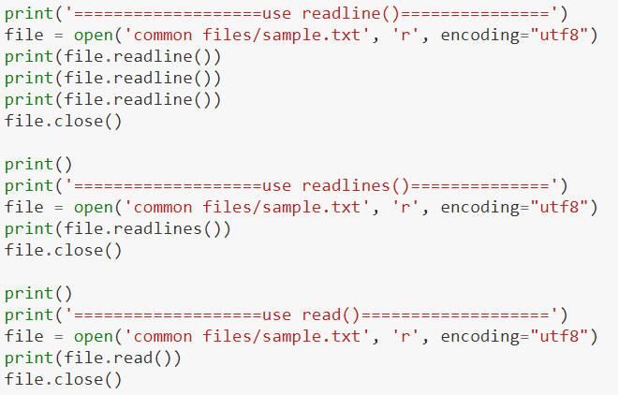
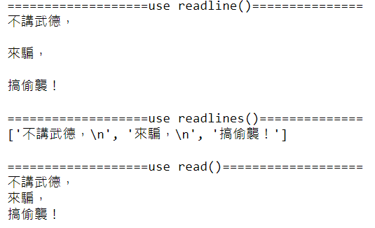
Read Content
readline() vs readlines() vs read()
Mode
Always remember to close the file

Slide 7
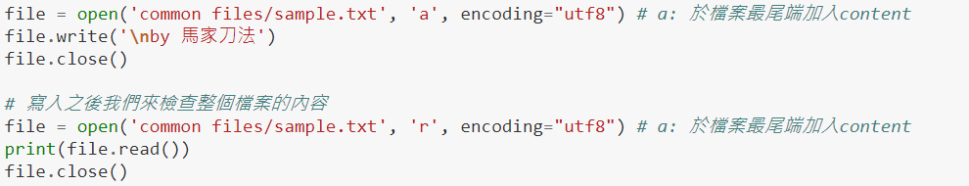
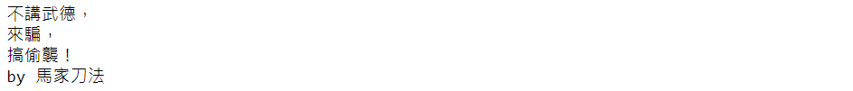
Write Content
Mode
New content here

Slide 8
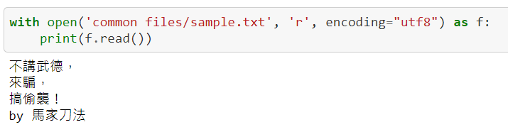
Another way to open a file
Use with open as to skip the closing file step.

Slide 9
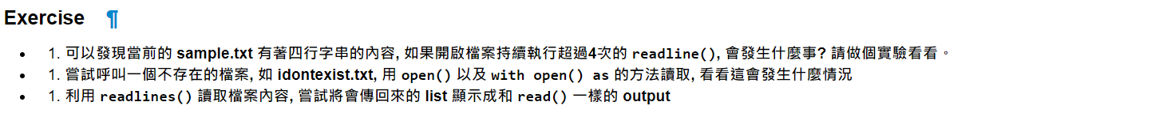
Exercise
Experience all the steps provided in the stated GitHub Link.
Try to implement what the exercises ask for.

Slide 10
Install Packages

Slide 11
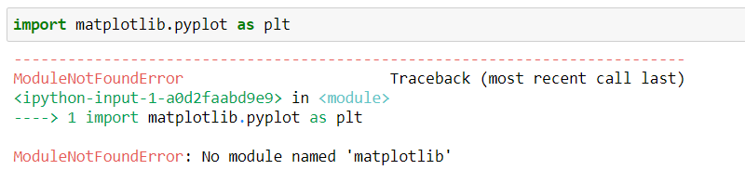
When we need to install a package???
Like Numpy, Pandas, Matplotlib, they are all packages. They might not be installed in your environment.
That is, you might face this error message when trying to import a package there is not exists.

Slide 12
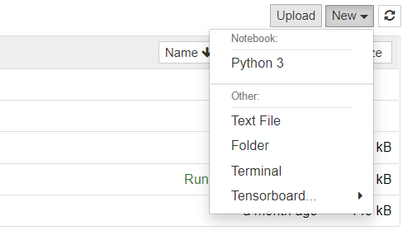
So, how we get the things installed???
Method 1, open your cmd/terminal, and run the pip install <package_name> (you need to make sure pip is already installed before)
If you are using Jupyter, just open a new terminal.
Method 2, just simply type ! pip install <package_name> on your code block.

Slide 13
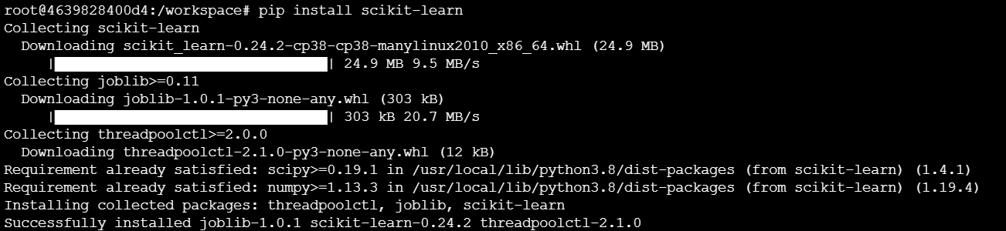
So, how we get the things installed???
Method 1:

Slide 14
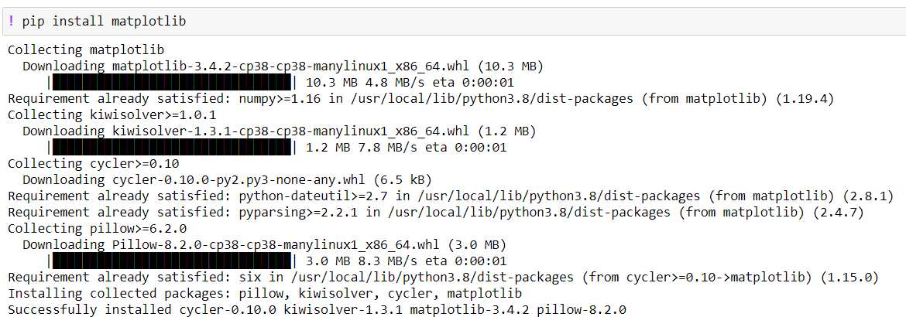
So, how we get the things installed???
Method 2:

Slide 15
Print out content in Jupyter

Slide 16
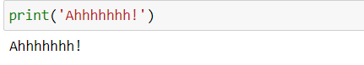
Print out content
To show result of your code, you may simply use print() to print out the content.
Refer to this reference to see another ways to print out things

Slide 17
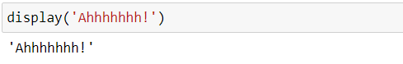
Print out content
Or use the display() function, which is the built-in function from IPython.core

Slide 18
Release variable from memory

Slide 19
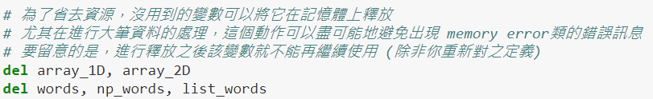
Release a variable
Some variables may occupy much space of memory, which is a waste when they are not used for further analysis. Use del to release it.

Slide 20
Numpy

Slide 21
Import
Normally, we import the Numpy package as follow:
Make a shorter name, so that we can more convenient to call the function from Numpy

Slide 22
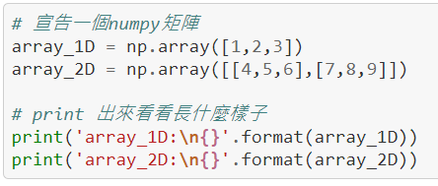
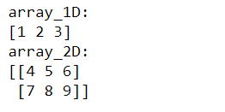
Declaration of Numpy Arrays
Usually, we will create a list to create an array at first, and convert it to Numpy array with np.array()
You may also use np.ones() or np.zeros() to create a one or zero array.

Slide 23
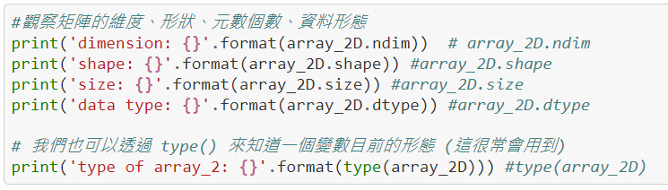
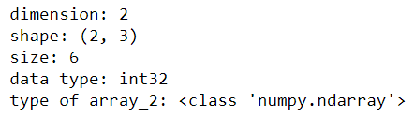
Get basic information of a Numpy array
We sometimes need to check on the basic information of a Numpy array to do further data exploration. Here are some examples:

Slide 24
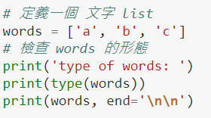
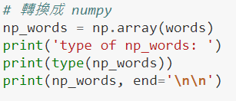
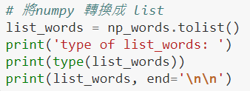
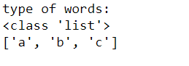
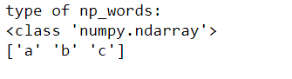
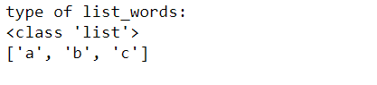
Conversion between list and Numpy array
Numpy arrays are not designed only for numbers, you may assign string to them as well. Below shows the example and how to do conversion between list and Numpy array.

Slide 25
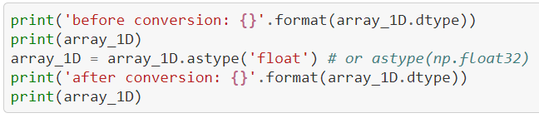
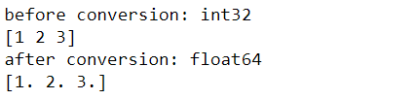
Change the data type of elements in a Numpy array
There might face the need of changing a data type of elements in an array, use astype() to change it for Numpy array.

Slide 26
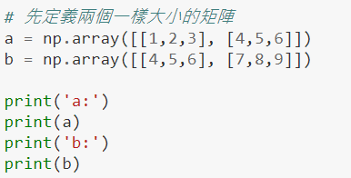
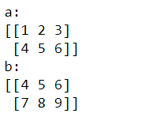
Perform basic element-wise operation
Numpy provides some element-wise operations for Numpy arrays, here are some examples:

Slide 27
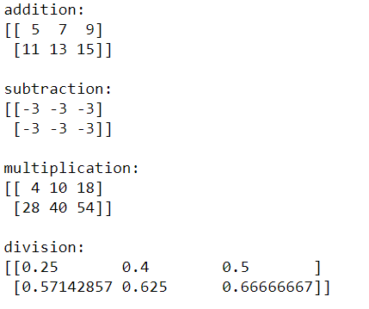
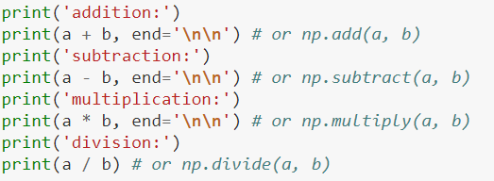
Perform basic element-wise operation
Numpy provides some element-wise operations for Numpy arrays, here are some examples:

Slide 28
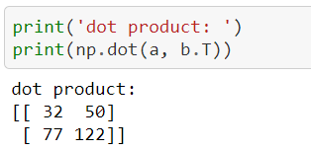
Perform basic matrix operation
Dot product is the simplest matrix operation of arrays, here is the example to use it to Numpy arrays.

Slide 29
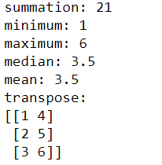
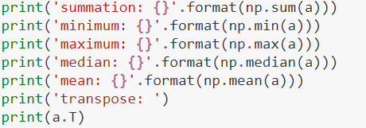
Other calculation of Numpy arrays
Here demonstrates some other calculations you can apply to a Numpy array.

Slide 30
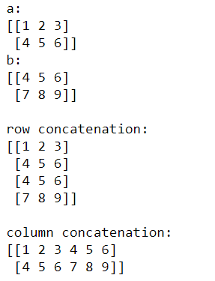
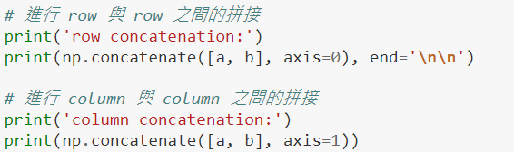
Concatenation of Numpy arrays
Use np.concatenate() to combine two or more Numpy arrays.

Slide 31



Concatenation of other dimension
np.concatenate() is not limited only for 2D arrays. The parameter ‘axis’ helps you to do combine arrays target axis.
axis = 0 [Rows]
axis = 1 [Cols]
axis = 2 [3rd Dim]

Slide 32
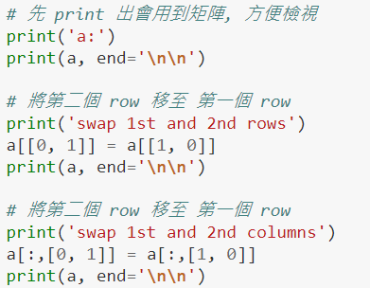
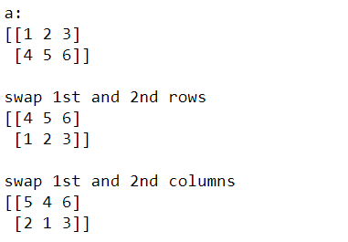
Swapping of Numpy arrays
We can also swap between two rows or columns of Numpy arrays.

Slide 33
Exercise
Experience all the steps provided in the stated GitHub Link.
Try to implement what the exercise ask for.

Slide 34
Pandas

Slide 35
Import
Normally, we import the Pandas package as follow:
Make a shorter name, so that we can more convenient to call the function from Pandas

Slide 36
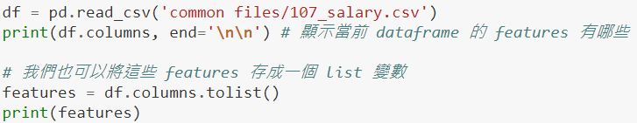
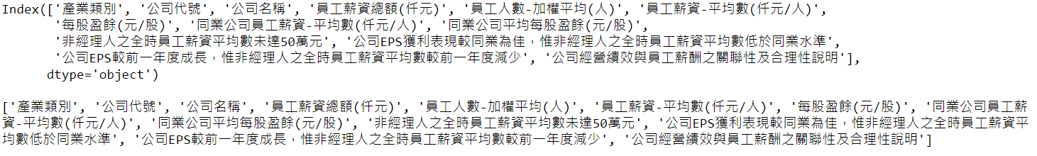
Read csv files to Pandas Dataframe
Use pd.read_csv() to read a csv files. This will return a Pandas.DataFrame result.

Slide 37
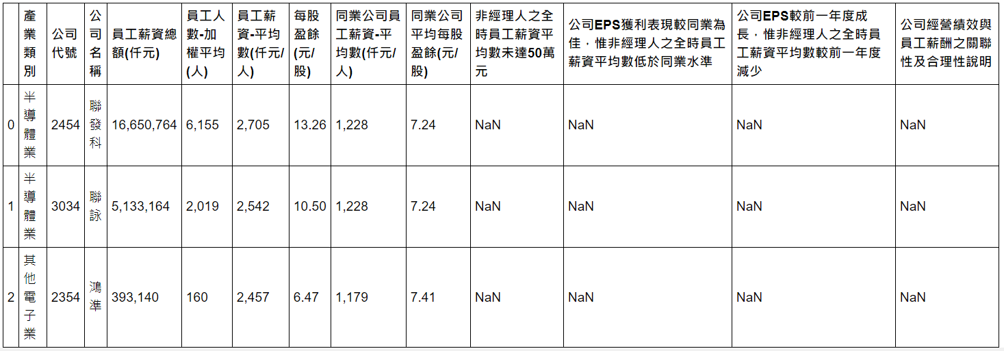
Print the some data of DataFrame
Here are the examples to print out the first n and last n data from dataframe.

Slide 38
Set to show up all columns
Sometimes a dataframe might consists too many columns, which will not showed out all of them as default. To make this available, try the settings below:

Slide 39
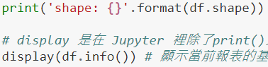
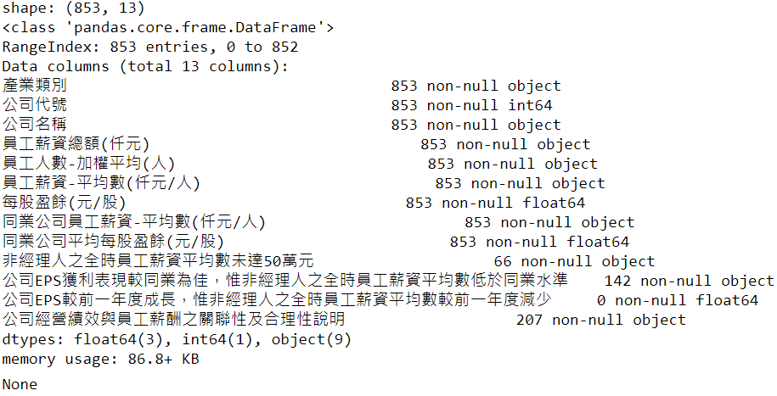
Show basic information of a dataframe
Use shape() to show out the dimension of dataframe, while info() helps to show out the summary of a dataframe.

Slide 40
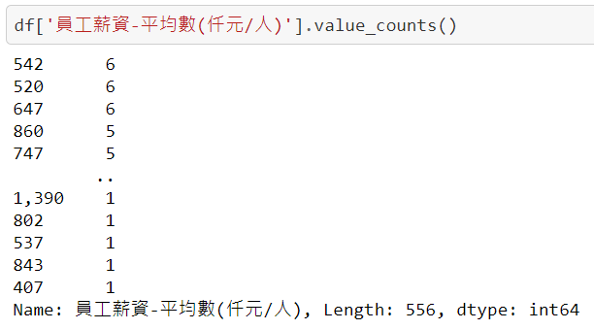
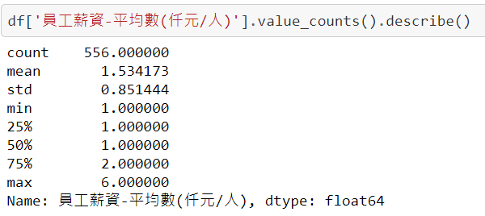
Show basic information of a column
Use value_counts() to show out some each value count of a column. You may also add describe() to make a summary.

Slide 41
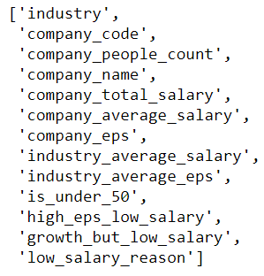
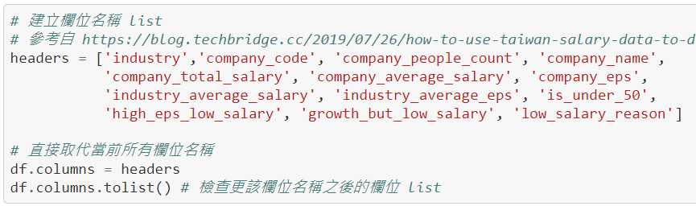
Change column names of DataFrame
The column names in a dataframe might sometimes contains long and complicated names, you may change them into simply one.

Slide 42
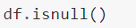
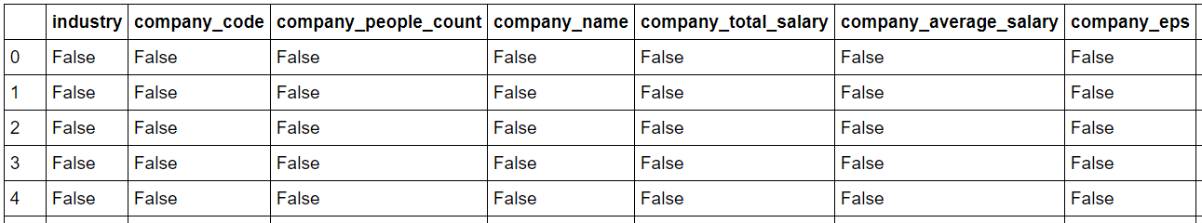
Data Cleaning (Null Values)
Datasets might contain of null values or duplicated values, do data cleaning could help us to construct a better data analysis.
Use isnull() to show see whether each data contains null value.

Slide 43
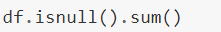
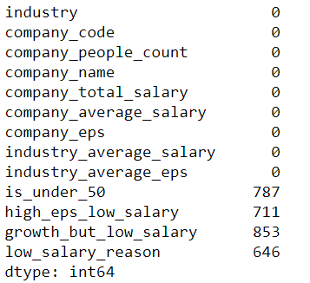
Data Cleaning (Null Values)
You can also add sum() to get summary.

Slide 44
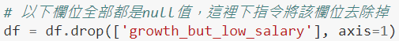
Data Cleaning (Null Values)
There usually have three ways to deal with null values.
1. Delete column. [Use drop()]
axis=0 : delete whole row
axis=1 : delete whole column

Slide 45
Data Cleaning (Null Values)
There usually have three ways to deal with null values.
2. Delete all data that contain any null value. [Use dropna()]

Slide 46
Data Cleaning (Null Values)
There usually have three ways to deal with null values.
3. Replace value for string column. [Use replace()]
Null value
So that the replacement only focus on string

Slide 47
Data Cleaning (Null Values)
There usually have three ways to deal with null values.
4. Replace value for numbers column. [Use fillna()]
Replace null with 0, you may replace it with mean, median, etc

Slide 48
Data Cleaning (Duplicated Values)
One of the way to deal with duplicated value is to delete all extra duplicated data.
Use duplicated() to check the number of duplicated data.
Use drop_duplicates() to delete all extra duplicated data.
keep=‘first’ means do not count in the first duplicated data.
You can also set keep=‘last’, which will not count the last duplicated data

Slide 49

Change data type of a column
You can change the data type of a column, here is one of the example of converting the data type of elements in a column from string to integer.

Slide 50


Replace a specify value of a column
Like shown in the example below, use replace() to replace all “V” in a columm into True.
Before
After

Slide 51



Sampling
Use sample() to get some examples from dataframe.

Slide 52

Query
Pandas also provide us to do query on dataframe, below is one of the example: (You may have to learn how to google keywords to get query method you want)

Slide 53

Pandas Dataframe to Numpy array
Use values() to convert dataframe to numpy array.

Slide 54

Pandas Dataframe to Numpy array
You can also select the columns that are needed to be converted instead of convert whole dataframe into array.

Slide 55


Create and Save Dataframe to csv file
Create your own dataframe and save it into csv file.

Slide 56
Exercise
Experience all the steps provided in the stated GitHub Link.
Try to implement what the exercises ask for.

Slide 57
Matplotlib

Slide 58
Import
Normally, we import the Matplotlib.pyplot package as follow:
Make a shorter name, so that we can more convenient to call the function from Matplotlib.pyplot

Slide 59

Some settings you may need.
Matplotlib is not showing the Chinese word as default, to make this available, you may to set up some settings.
Type your favourite Chinese font family. (You have to make sure your selected font family is existed in your matplotlib environment)

Slide 60


Simple Bar Chart
The code below demonstrate a simple implementation of bar chart. Pay attention on those settings, which help to make better visualization of chart.

Slide 61


Simple Line Chart
The code below demonstrate a simple implementation of line chart. Pay attention on those settings, which help to make better visualization of chart.

Slide 62


Simple Pie Chart
The code below demonstrate a simple implementation of pie chart.

Slide 63


Stacked Bar Chart
Matplotlib provide us to plot multiple bars in a graph as well. Relax, it’s just multiple plt.bar() functions.

Slide 64


Grouped Bar Chart
Matplotlib provide us to plot multiple bars in a graph as well.

Slide 65


Multiple Line Chart
Matplotlib provide us to plot multiple lines in a graph as well. Relax, it’s just multiple plt.plot() functions.

Slide 66


Read image and show it
We can also show out an image via Matplotlib.

Slide 67

Subplot vs Subplots
We can also assign multiple charts into one graph. There normally provide two ways: subplot and subplots

Slide 68

Subplot (Recommended)

Slide 69

Subplots

Slide 70

Save your plots
Use plt.savefig() to save your plots.
Path you plan to save your plots

Slide 71

Exercise
Experience all the steps provided in the stated GitHub Link.
Try to implement what the exercises ask for.

Slide 72


Don’t stop at here
At last, let see what matplotlib can do.
With Seaborn
With Wordcloud
Refer to basic implementation in here to know more details

